Slide 1
Tutorial 11
Basic AI:
A* Pathfinding
Computer Games Programming
Southampton Solent University

Slide 2
Pathfinding – Get from point A to point B
A
B
Computer Games Programming
Southampton Solent University – 2013

Slide 3
Pathfinding – Get from point A to point B
A
B
Computer Games Programming
Southampton Solent University

Slide 4
Pathfinding – Get from point A to point B
A
B
Computer Games Programming
Southampton Solent University

Slide 5
Pathfinding – Get from point A to point B
A
B
Computer Games Programming
Southampton Solent University

Slide 6
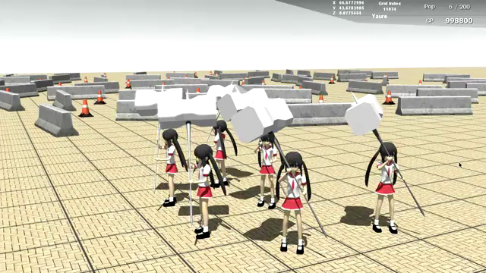
“RTS A*Pathfinding with Squads” by y4ure
http://www.youtube.com/watch?v=nGC_kBCoHYc
Computer Games Programming
Southampton Solent University

Slide 7
Pathfinding – Get from point A to point B
Straight Line
light
+ Fast, simple, not a resource drain
- Not guaranteed to make it to goal
resource
usage
A* Pathfinding
+ will find a path if one exists
- makes characters look robotic
Enhanced A* Pathfinding
heavy
+ more realistic movement
- more resource intensive
Computer Games Programming
Southampton Solent University

Slide 8
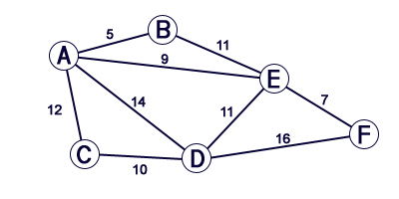
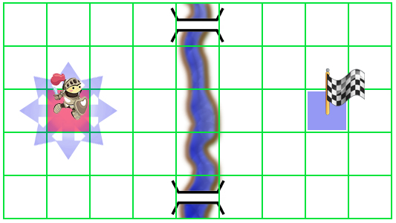
A* Pathfinding
Navigate obstacles to find shortest (or close to shortest) path between 2 points.
To travel, terrain needs to be divided into regions linked by paths
Computer Games Programming
Southampton Solent University

Slide 9
Dijkstra’s Algorithm
Computer Games Programming
Southampton Solent University

Slide 10
Dijkstra’s Algorithm
Devised:
1956 by Edsgar Dijkstra
“For a demonstration for noncomputing people you have to have a problem statement that non-mathematicians can understand; they even have to understand the answer.
So I designed a program that would find the shortest route between two cities in the Netherlands, using a somewhat reduced road-map of the Netherlands.”
Edsgar Dijkstra, August 2001
Computer Games Programming
Southampton Solent University

Slide 11
Solving Dijkstra’s Algorithm
Problem:
Find the cost of the shortest path from A to F
Computer Games Programming
Southampton Solent University

Slide 12
Solving Dijkstra’s Algorithm
Getting started:
Start at A
Calc smallest cumulative cost to get from start node to querying node (i.e. 0)
Store cost on node.
Add A to Solved Vertex List.
Continuing.
For every node in Solved List:
Find all connected nodes:
Query each connected node in turn
Calculate smallest cumulative distance to get from start node to query node.
Store cost on node.
Select node with lowest stored cost
Add node to solved vertex list
Node = Target node? Return value and stop
Solved Vertices
Computer Games Programming
Southampton Solent University

Slide 13
Solving Dijkstra’s Algorithm
Start at A (current vertex = A)
Label vert with smallest cumulative cost of travelling from start to this point (i.e. 0)
Add current vert to “solved” list
Computer Games Programming
Southampton Solent University

Slide 14
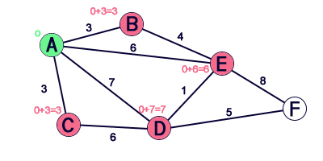
Solving Dijkstra’s Algorithm
For all verts in solved list:
Find connected nodes
Calculate smallest cumulative cost of getting to them
Computer Games Programming
Southampton Solent University

Slide 15
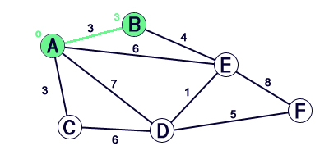
Solving Dijkstra’s Algorithm
Choose node with smallest value
Add to solved list
Computer Games Programming
Southampton Solent University

Slide 16
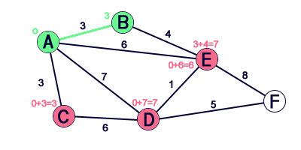
Solving Dijkstra’s Algorithm
For all verts in solved list:
Find connected nodes
Calculate smallest cumulative cost of getting to them
Computer Games Programming
Southampton Solent University

Slide 17
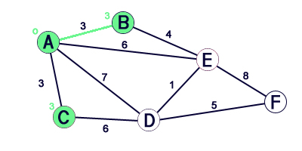
Solving Dijkstra’s Algorithm
Choose node with smallest value
Add to solved list
Computer Games Programming
Southampton Solent University

Slide 18
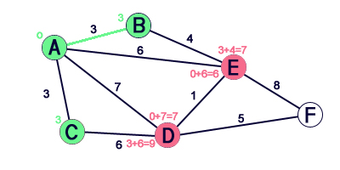
Solving Dijkstra’s Algorithm
For all verts in solved list:
Find connected nodes
Calculate smallest cumulative cost of getting to them
Computer Games Programming
Southampton Solent University

Slide 19
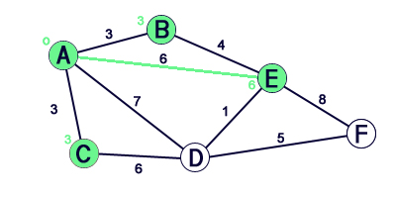
Solving Dijkstra’s Algorithm
Choose node with smallest value
Add to solved list
Computer Games Programming
Southampton Solent University

Slide 20
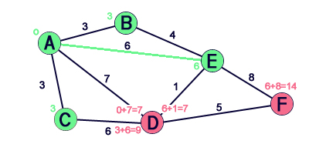
Solving Dijkstra’s Algorithm
For all verts in solved list:
Find connected nodes
Calculate smallest cumulative cost of getting to them
Computer Games Programming
Southampton Solent University

Slide 21
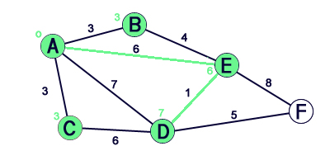
Solving Dijkstra’s Algorithm
Choose node with smallest value
Add to solved list
Computer Games Programming
Southampton Solent University

Slide 22
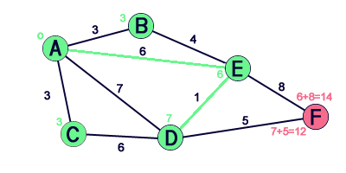
Solving Dijkstra’s Algorithm
For all verts in solved list:
Find connected nodes
Calculate smallest cumulative cost of getting to them
Computer Games Programming
Southampton Solent University

Slide 23
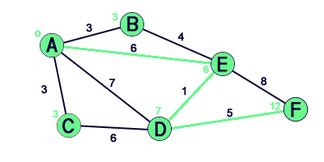
Solving Dijkstra’s Algorithm
Choose node with smallest value
Add to solved list
Computer Games Programming
Southampton Solent University

Slide 24
Solving Dijkstra’s Algorithm
Node == Target?
Return value (12) and end
Computer Games Programming
Southampton Solent University

Slide 25
A* Pathfinding – Travelling
1) Estimate the distance between the start square and the goal square.

Slide 26
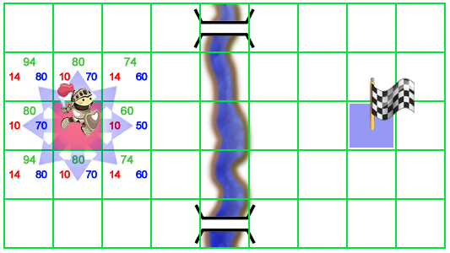
A* Pathfinding – Travelling
2) Explore the surrounding squares and find the one most likely to be on the shortest route.

Slide 27
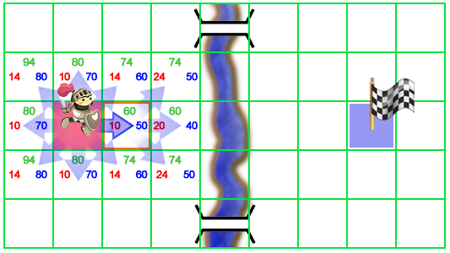
A* Pathfinding – Travelling
3) Move to that square

Slide 28
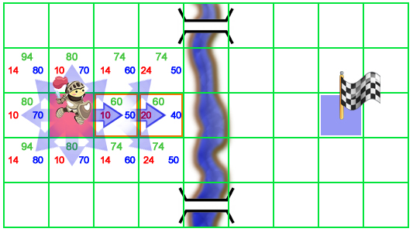
A* Pathfinding – Travelling
3) Repeat (Explore, Move, Explore, Move) until we reach the goal square

Slide 29
Dijkstra’s Algorithm vs A* Pathfinding
Shortcomings of
Dijkstra’s Algorithm

Slide 30
Dijkstra’s Algorithm vs A* Pathfinding
Shortcomings of
Dijkstra’s Algorithm:
Only tells you cost of shortest path, doesn’t tell you the actual path

Slide 31
Dijkstra’s Algorithm vs A* Pathfinding
Shortcomings of
Dijkstra’s Algorithm:
Only tells you cost of shortest path, doesn’t tell you the actual path –
Solve by:
storing the ID of previous node to label.
create a linked list of nodes from target back to start.
walk it in reverse to travel from start to target.

Slide 32
Dijkstra’s Algorithm vs A* Pathfinding
Shortcomings of
Dijkstra’s Algorithm:
Travel to Target node is random – you could walk to EVERY node before stumbling upon the Target node.

Slide 33
Dijkstra’s Algorithm vs A* Pathfinding
Shortcomings of
Dijkstra’s Algorithm:
Travel to Target node is random – you could walk to EVERY node before stumbling upon the Target node.
Solve by:
Using Heuristics to “pull” node searching towards the target.

Slide 34
Dijkstra’s Algorithm vs A* Pathfinding
Shortcomings of
Dijkstra’s Algorithm:
Travel to Target node is random – you could walk to EVERY node before stumbling upon the Target node.
Solve by:
Using Heuristics to “pull” node searching towards the target.
Heuristics = “to learn by evaluation, experimentation, trial-and-error”

Slide 35
Dijkstra’s Algorithm vs A* Pathfinding
Shortcomings of
Dijkstra’s Algorithm:
What if the shortest route isn’t the most suitable route?

Slide 36
Dijkstra’s Algorithm vs A* Pathfinding
Shortcomings of
Dijkstra’s Algorithm:
What if the shortest route isn’t the most suitable route?
Also solve by:
Using Heuristics to avoid undesirable nodes or be attracted towards desirable ones.

Slide 37
Dijkstra’s Algorithm vs A* Pathfinding
Shortcomings of
Dijkstra’s Algorithm:
What if the shortest route isn’t the most suitable route?
Also solve by:
Using Heuristics to avoid undesirable nodes or be attracted towards desirable ones.
A* = Dijkstra’s Algorithm + linked lists + Heuristics

Slide 38
Calculating the Cost of Movement
A* Algorithm based on the equation:
F = G + H
where
F =
G =
H =
Total Cost of Moving from Target to Goal via
Current Square.
Accumulated cost of moving from Target to Current
Square
Estimated cost of moving from Current Square to
Target Square (known as the Heuristic)

Slide 39
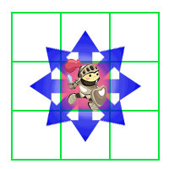
Calculating G (cost of movement)
Remember: KEEP IT SIMPLE
Lets say cost of moving in Cardinal Directions (N, S , E, W) costs 10 points:
10
10
10
10

Slide 40
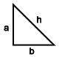
Calculating G (cost of movement)
Remember: KEEP IT SIMPLE
Lets allow our character to move diagonally too. We want to maintain the cost ratio for moving diagonally, though.
10
using Pythagoras’ theorum:
h² = a² + b²
where
a = 10, b = 10
10
10
h = √(10² + 10²)
= √200
h = 14.14,
rounded down to 14
for simplicity’s sake.
10

Slide 41
Calculating G (cost of movement)
Remember: KEEP IT SIMPLE
So moving in Diagonals costs 14 points:
14
10
14
10
10
14
10
14

Slide 42
Calculating H (Estimated Cost to Target)
The Manhattan Method:
The sum of the difference between the x and y position of the current square and the target square:
e.g. abs( current.x – target.x) + abs(current.y –target.y)
Keep it simple, so:
Ignore diagonals – North, South, East and West only
Ignore obstacles – “as the crow flies” distance
Use same movement cost as G: 10 points per square move

Slide 43
Calculating H (Estimate cost to Target)
A
B
C
Let’s calculate the H-Values for squares A, B and C using the Manhattan Method and our travelling costs...

Slide 44
Calculating H (Estimate cost to Target)
A
B
C
Calculating H value for A:
A.x = T.x -1 | A.y = T.y - 2 | Value
offset = abs(-1) = 1 | offset = abs(-2) = 2 | (1 + 2) * 10 = 30

Slide 45
Calculating H (Estimate cost to Target)
A
B
C
Calculating H value for B:
A.x = T.x -4 | A.y = T.y + 1 | Value
offset = abs(-4) = 4 | offset = abs(1) = 1 | (4 + 1) * 10 = 50

Slide 46
Calculating H (Estimate cost to Target)
A
B
C
Calculating H value for C:
A.x = T.x -0 | A.y = T.y + 2 | Value
offset = abs(0) = 0 | offset = abs(2) = 2 | (0 + 2) * 10 = 20

Slide 47
Storing (and discarding) path squares
To keep track of the paths we are taking, we need 2 lists to store the squares we encounter.
The Open List
Stores squares that we have already encountered and calculated their G-score.
The Closed List
Stores squares that will not be considered again (either we have occupied them already or we couldn’t get to them)

Slide 48
Storing (and discarding) path squares
The data we need to store on each square is:
F-Score:
Estimated Total Cost of Moving from Target to Goal via Current Square.
Parent Square:
The square we moved to get to this square. Needed to trace a path BACK from the target to the start square.
Reversed, this path gives us the optimal route from the start square to the target square.

Slide 49
Let’s Go!
A B C D E F G H I
1
2
3
4
5
Open List
Closed List
Select Start Square (B3)
Give it a G-score of 0 (as we haven’t moved anywhere)
Set its Parent to NULL (indicating it’s the start square)
Put it on the closed list (we won’t need to recalculated it again)

Slide 50
Let’s Go!
A B C D E F G H I
1
2
3
4
5
Open List
Closed List
B3

Slide 51
Let’s Go!
A B C D E F G H I
1
2
3
4
5
Open List
Closed List
B3
From Current Position (B3), check each adjacent squares and
If square cannot be reached, add to closed list and ignore
Calculate G score
Add square to open list if not already in list OR compare new G-score to old. If new score is lower, update score and set Parent to Current Position (B3) else do nothing.

Slide 52
Let’s Go!
A B C D E F G H I
1
2
3
4
5
Open List
A2, B2, C2, A3, B3, C3, A4, B4, C4
Closed List
B3

Slide 53
Let’s Go!
A B C D E F G H I
1
2
3
4
5
Open List
A2, B2, C2, A3, B3, C3, A4, B4, C4
Closed List
B3
From Current Position (B3)
Choose the square in the open list with the lowest F-score and move to it

Slide 54
Let’s Go!
A B C D E F G H I
1
2
3
4
5
Open List
A2, B2, C2, A3, B3, C3, A4, B4, C4
Closed List
B3

Slide 55
Let’s Go!
A B C D E F G H I
1
2
3
4
5
Open List
A2, B2, C2, A3, B3, A4, B4, C4
Closed List
B3, C3
From Current Position (C3)
Remove Current Position (C3) from the Open list and add to the closed list.

Slide 56
Let’s Go!
A B C D E F G H I
1
2
3
4
5
Open List
A2, B2, C2, A3, B3, A4, B4, C4
Closed List
B3, C3
From Current Position (C3), check each adjacent squares and
If square cannot be reached, add to closed list and ignore
Calculate G score
Add square to open list if not already in list OR compare new G-score to old. If new score is lower, update score and set Parent to Current Position (C3) else do nothing.

Slide 57
Let’s Go!
A B C D E F G H I
1
2
3
4
5
Open List
A2, B2, C2, A3, B3, A4, B4, C4, D2, D3, D4
Closed List
B3, C3

Slide 58
Let’s Go!
A B C D E F G H I
1
2
3
4
5
Open List
A2, B2, C2, A3, B3, A4, B4, C4, D2, D3, D4
Closed List
B3, C3
From Current Position (C3)
Choose the square in the open list with the lowest F-score and move to it

Slide 59
Let’s Go!
A B C D E F G H I
1
2
3
4
5
Open List
A2, B2, C2, A3, B3, A4, B4, C4, D2, D3, D4
Closed List
B3, C3

Slide 60
Let’s Go!
A B C D E F G H I
1
2
3
4
5
Open List
A2, B2, C2, A3, B3, A4, B4, C4, D2, D3, D4
Closed List
B3, C3
From Current Position (D3)
Remove Current Position (D3) from the Open list and add to the closed list.

Slide 61
Let’s Go!
A B C D E F G H I
1
2
3
4
5
Open List
A2, B2, C2, A3, B3, A4, B4, C4, D2, D4
Closed List
B3, C3, D3

Slide 62
Let’s Go!
A B C D E F G H I
1
2
3
4
5
Open List
A2, B2, C2, A3, B3, A4, B4, C4, D2, D4
Closed List
B3, C3, D3
From Current Position (D3), check each adjacent squares and
If square cannot be reached, add to closed list and ignore
Calculate G score
Add square to open list if not already in list OR compare new G-score to old. If new score is lower, update score and set Parent to Current Position (D3) else do nothing.

Slide 63
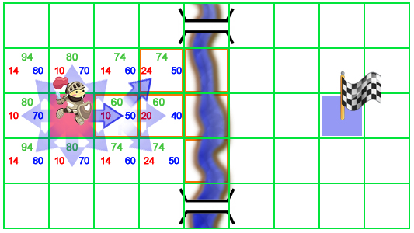
Let’s Go!
A B C D E F G H I
1
2
3
4
5
Open List
x
A2, B2, C2, A3, B3, A4, B4, C4, D2, D4
x
x
Closed List
B3, C3, D3, E2, E3, E4
From Current Position (D3)
Choose the square in the open list with the lowest F-score and move to it.
In the event of an F-score tie make an arbitrary choice from the candidates

Slide 64
Let’s Go!
A B C D E F G H I
1
2
3
4
5
Open List
x
A2, B2, C2, A3, B3, A4, B4, C4, D2, D4
x
x
Closed List
B3, C3, D3, E2, E3, E4
From Current Position (D2)
Continue processing squares and moving positions until path to target is found

Slide 65
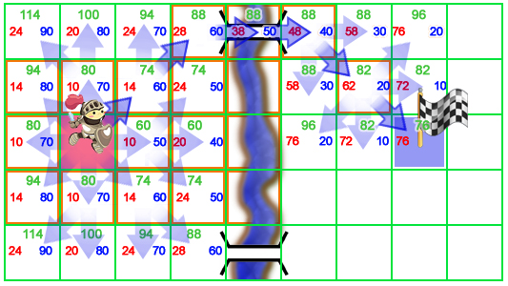
Let’s Go!
A B C D E F G H I
1
2
3
4
5
Open List
x
D5, C1, C5, B1, B5, A1, A5, G1, F2, H1, H2, G3, F3
x
x
Closed List
B3, C3, D3, E2, E3, E4, D2, C2, D4, C4, B2, B4, D1, E1, F1, G2, H3
Path Found!
From Target, trace back through PARENT squares to start square, then reverse the list to show shortest path:
B3 -> C2 -> D1 -> E1 -> F1 -> G2 -> H3

Slide 66
Intelligent (seeming) Path-Finding
Heuristic Weighting
Terrain penalties (mud, rock, desert, forest)
Per-character penalties (armoured can’t cross water, but thieves can)
Tactical advantages (the slow route may be safer, and therefore preferable)
Path Blocking and Selection
Character already occupying square?
Mob flocking (groups of NPCs may chose different paths from lone NPCs)
Computer Games Programming
Southampton Solent University

Slide 67
Tutorial 11
Basic AI:
A* Pathfinding
Computer Games Programming
Southampton Solent University

